Slide 1




Data Mining of Housing Affordability
Bo Zhang
Kathy Chowaniec
Li Zhang
CS 593: Data Mining II: Advanced Algorithms
Professor Dehnad
May 4, 2017

Slide 2
Agenda
Overview
Problem Statement and Objectives
Steps Followed
Understanding the Dataset
Variables Examined
Data Preparation and Cleaning
Modeling Techniques Used:
Multiple Linear Regression
Logistic Regression
Principal Component Analysis (PCA)
Evaluation & Conclusions

Slide 3

Overview
The U.S. Department of Housing and Urban Development (HUD) has been conducting a national American Housing Survey annually since 1985
The Housing Affordability Data System (HADS) is a set of files derived from this survey to measure the affordability of housing units and the cost burden on households at a national and metropolitan level
The data contains important aspects such as household income, Fair Market rent, and Median Area Income
Fair Market Rent is the amount of money that a given property would require if it were open for leasing at the moment
This allows housing analysts/experts to be able to use a consistent set of affordability and cost burden measures
The dataset also includes several variables describing housing-level characteristics and housing population demographics
Source: https://catalog.data.gov/dataset/housing-affordability-data-system-hads
Notes:
The Housing Affordability Data System (HADS) is a set of files derived from the 1985 and later national American Housing Survey (AHS) and the 2002 and later Metro AHS. This system categorizes housing units by affordability and households by income, with respect to the Adjusted Median Income, Fair Market Rent (FMR), and poverty income. It also includes housing cost burden for owner and renter households. These files have been the basis for the worst case needs tables since 2001. The data files are available for public use, since they were derived from AHS public use files and the published income limits and FMRs. These dataset give the community of housing analysts the opportunity to use a consistent set of affordability measures.

Slide 4
Why is this important?
Lack of affordable housing is a crisis for both communities & individual households
According to the U.S. Bureau of Labor Statistics, housing is the largest annual expenditure for households in the United States
Families who pay more than 30 percent of their income for housing are considered “cost burdened” and often have difficulty affording necessities such as food, clothing, transportation and medical care
An estimated 12 million renter and homeowner households now pay more than 50 percent of their annual incomes for housing
Approximately 13.4 million renter households & 14.5 million owner households have housing affordability problems
Source: https://portal.hud.gov/hudportal/HUD?src=/program_offices/comm_planning/affordablehousing/

Slide 5
Problem Statement and Objectives
Objective: Analyze housing data and determine the criteria significant for the following :
Current Market Value
Housing Affordability
Problem Statement:
Why is there such a disparity in market values and housing affordability nationwide?
Questions to Answer:
How can we predict the current market value of housing?
What are the most important factors related to housing affordability?

Slide 6
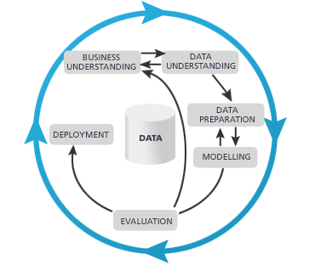
Steps Followed
1. Research/Business Understanding Phase
2. Data Understanding Phase
3. Data Preparation Phase
4. Modeling Phase
5. Evaluation Phase

Slide 7
Understanding the Dataset
Retrieved from https://www.huduser.gov/portal/datasets/hads/hads.html
National dataset selected for the year 2013
Data includes household demographics, housing characteristics and costs, and affordability measures
Originally 64,535 entries and 99 variables
Mix of categorical and numerical type of variables
Out of the 99 variables, we selected the most relevant (≈20) to examine in our regression models

Slide 8
Variables examined
Age of head of household (AGE1)
Number of people in household (PER)
Household Income (ZINC2)
Area median Income (LMED)
Region (REGION)
Other Monthly Costs (OTHERCOST)
Monthly Utility Costs (UTILITY)
Monthly Housing Costs (ZSMHC)
Fair Market Value (FMR)
Current Market Value of Unit (VALUE)
Central City/Suburban status (METRO3)
Number of units in building (NUNITS)
Number of rooms in unit (ROOMS)
Year unit was built (BUILT)
Structure Type (STRUCTURETYPE)
Cost Burden (BURDEN)
Owner/Renter Status (OWNRENT)
Number of bedrooms in unit (BEDRMS)
Occupancy Status (STATUS)

Slide 9
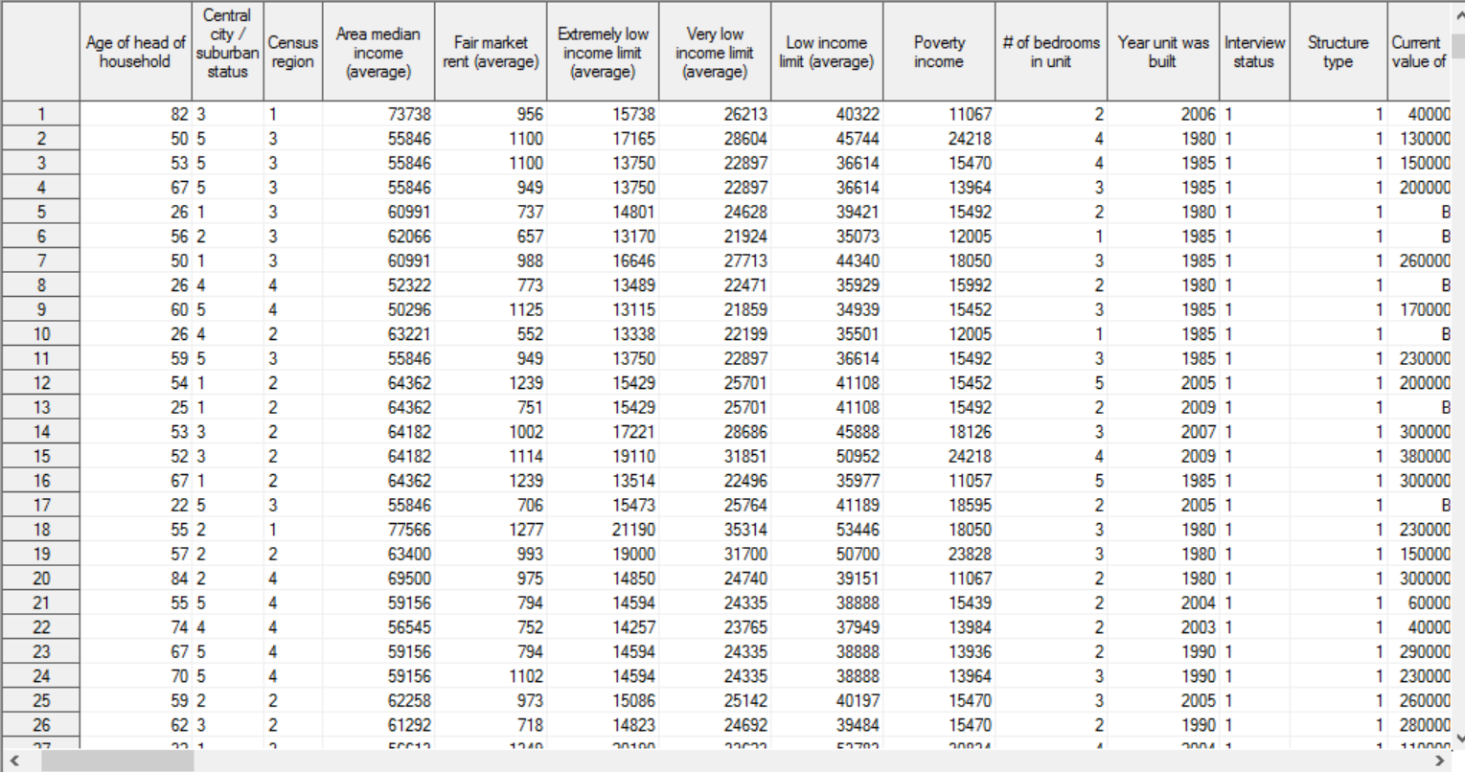
Sample Data

Slide 10
Data Preparation and Cleaning
Data filters used:
Removed records with blank AGE values and AGE < 18 (adult ages only)
For current market value analysis, we removed records with blank values and unreasonable values (i.e. $1)
Transformations applied:
Log transformations applied to Fair Market Rent(FMR), Area Median Income, Other Monthly Costs, and Current market value of unit
Square root transformations applied to Household Income, Monthly Housing Cost and Monthly Utility Cost

Slide 11
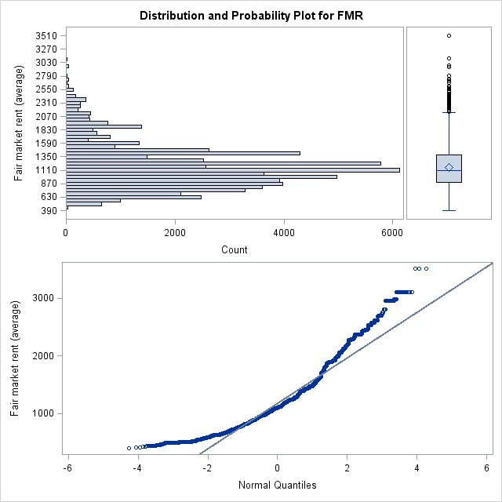
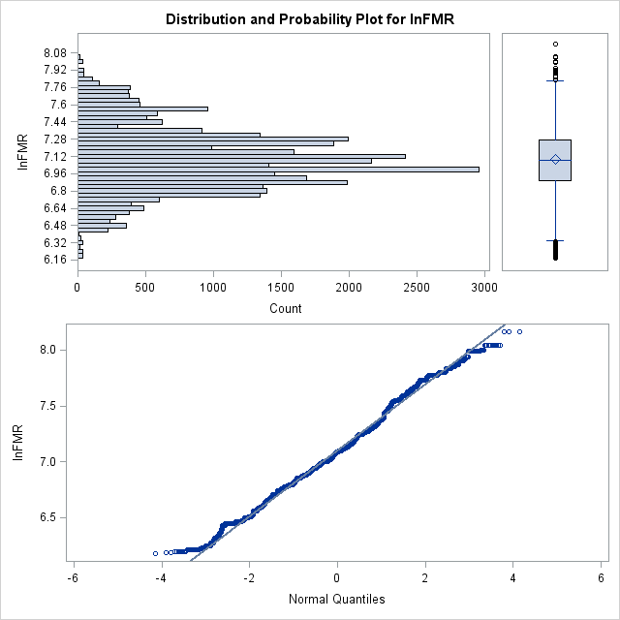
Data Transformation Example

Slide 12
Data Preparation and Cleaning
Indicator Variables:
We created indicator variables to represent the 4 geographic regions: northeast, south, midwest and west
We created an indicator variable to reflect if housing unit was owned or rented, as well as one for occupied/vacant
We created an indicator variable to represent the different location types of housing: suburb and central city
We created our own variable to use in logistic regression: affordable, based on housing cost burden estimates
Logic: housing cost less than 30% of income is affordable, above 30% is not affordable

Slide 13
Modeling Techniques Used
Multiple Linear Regression
Why?
To predict current market value of a housing unit (continuous variable)
Logistic Regression
Why?
To measure affordability (binary variable: affordable or unaffordable)
Principal Component Analysis
Why?
To eliminate collinearity among variables and to assist in dimension reduction of variables

Slide 14
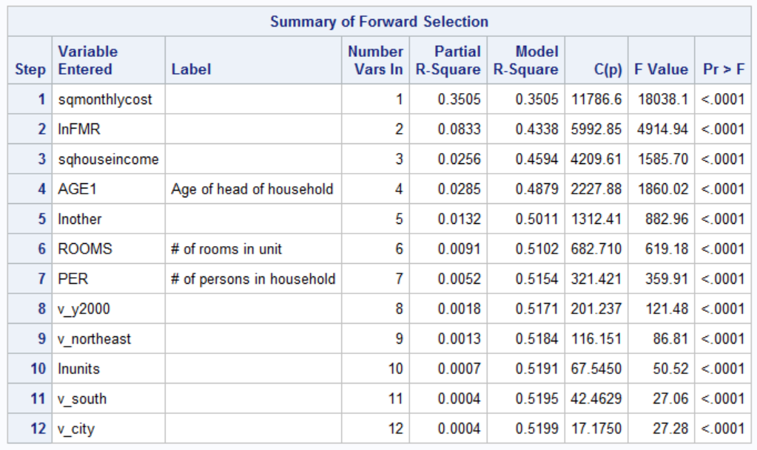
Multiple Linear Regression: Market Value
Goal: Predict the current market value of a unit (continuous variable)
Input predictors: ROOMS, AGE1, NUNITS, ZINC2, LMED, FMR, ZSMHC, BUILT, REGION, METRO3, OTHERCOST, UTILITY, STATUS, OWNRENT, PER
Forward Selection Results (Significance set to 0.05):
5 variables removed:

Slide 15
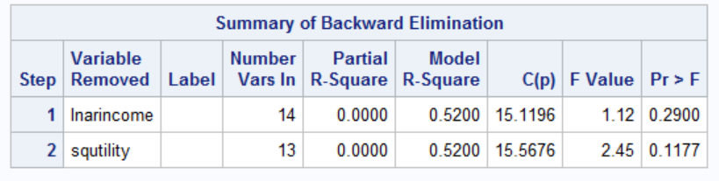
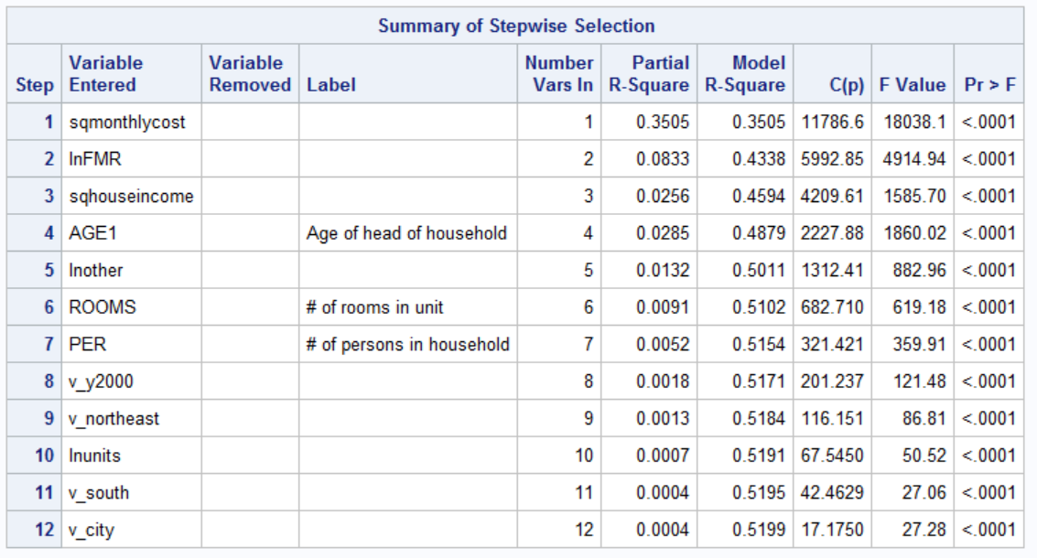
Multiple Linear Regression: Market Value
Backward Selection Results:
Median area income and utility cost
variables removed
Stepwise Selection Results with Significance set to 0.05:
Same variables removed as in
forward selection
MAXR Results:
Verifies model chosen by forward and
stepwise selection methods is
significant/best 12-variable model

Slide 16
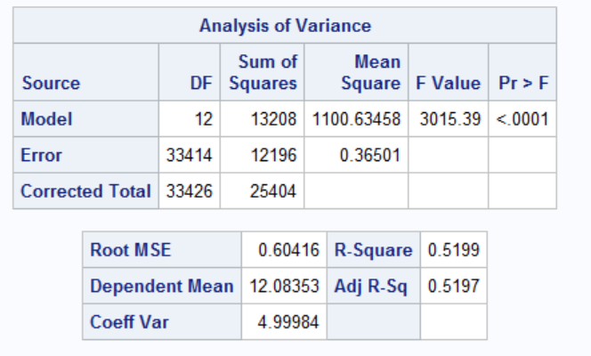
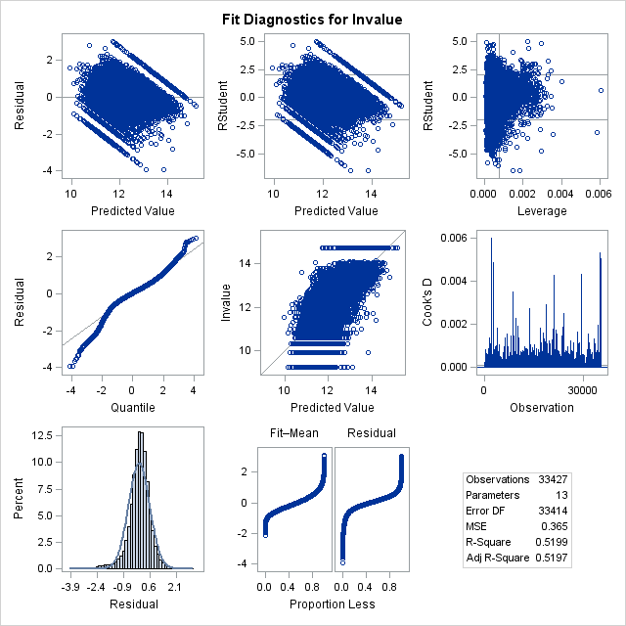

Multiple Linear Regression: Market Value
Regression Results using this 12-variable model:
Model is overall significant (F value)
All predictor coefficients are significant at 0.05 level
Variance Inflation Factors (VIF) values are low
Residuals appear randomly distributed
QQ plot shows some abnormality
(data not entirely normally distributed)
$R^{2 }=$ 0.5199

Slide 17
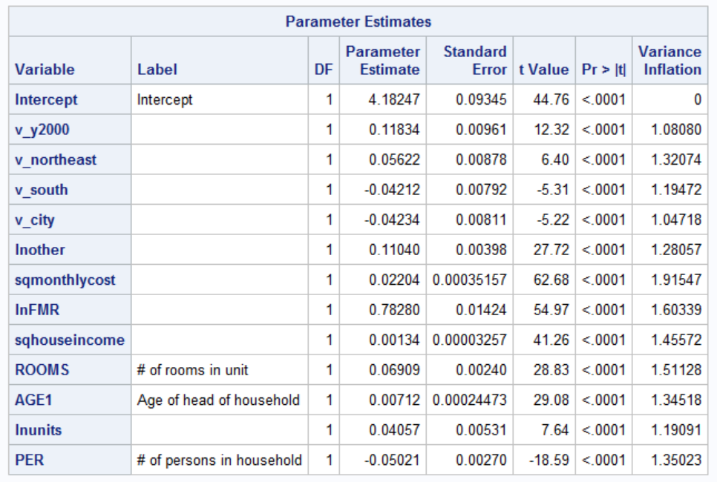
Multiple Linear Regression: Market Value
Interesting Points:
Negative relationships between market value and
southern region, city areas, and number of people
Most significant predictor based on coefficient values
is Fair Market Rent
Location matters (south vs. northeast)
Year unit was built is important after 2000
Model Equation:
Current Market Value = 4.182 + 0.118(BUILT>2000) +
0.056(northeast region) – 0.042(south region) – 0.042(city) + 0.110(other costs) + 0.022(monthly housing costs) + 0.783(FMR) + 0.001(household income)
+ 0.069(number of rooms) + 0.007(age) + 0.040(number of units) – 0.050(number of people)

Slide 18
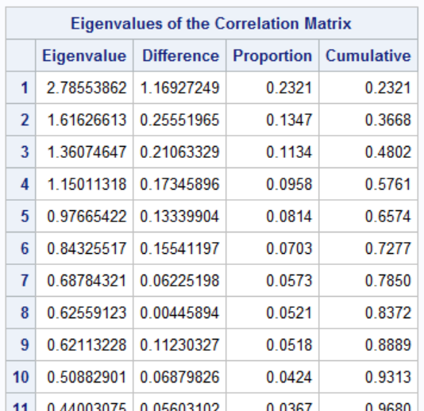
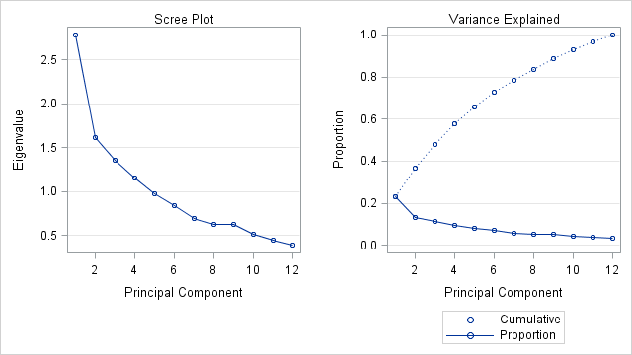
Principal Component Analysis: Market Value
All variables were standardized before applying PCA
First nine principal components were selected based on
“elbow” method and cumulative variability
accounted for by components (≈ 89%)

Slide 19
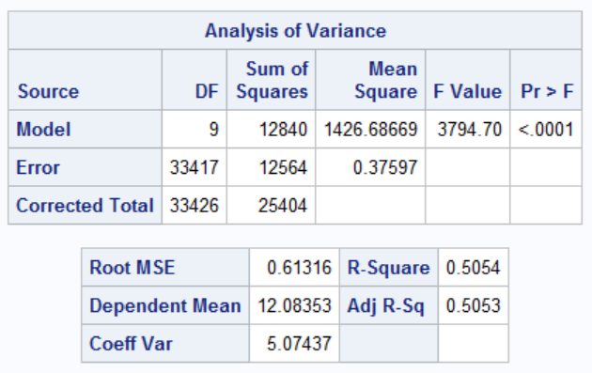
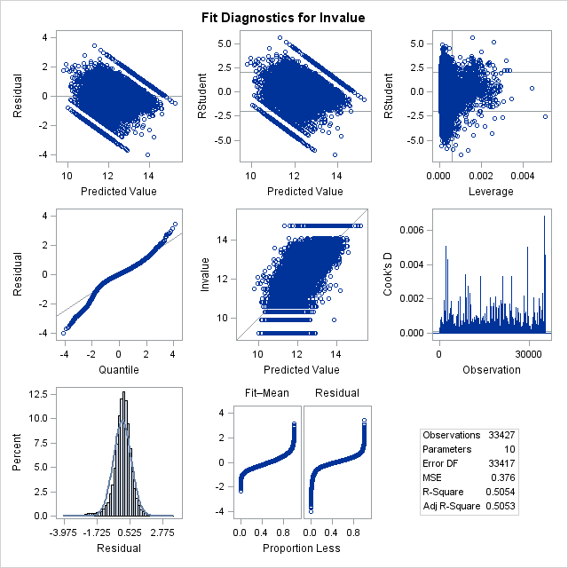
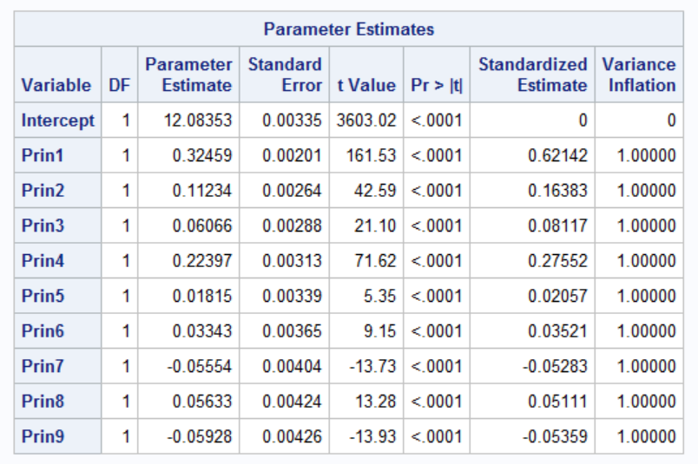

Regression using Principal Components
Model is overall significant (F value)
All predictor coefficients are significant at 0.05 level
Residuals appear randomly distributed
QQ plot shows some abnormality (data not entirely normally distributed)
$R^{2 }=0.5054$
Equation:
Market value =
12.083 + 0.324(Prin1) + 0.112(Prin2)
+ 0.061(Prin3) + 0.224(Prin4)
+ 0.018(Prin5) + 0.033(Prin6)
- 0.055(Prin7) + 0.056(Prin8)
-0.059(Prin9)

Slide 20

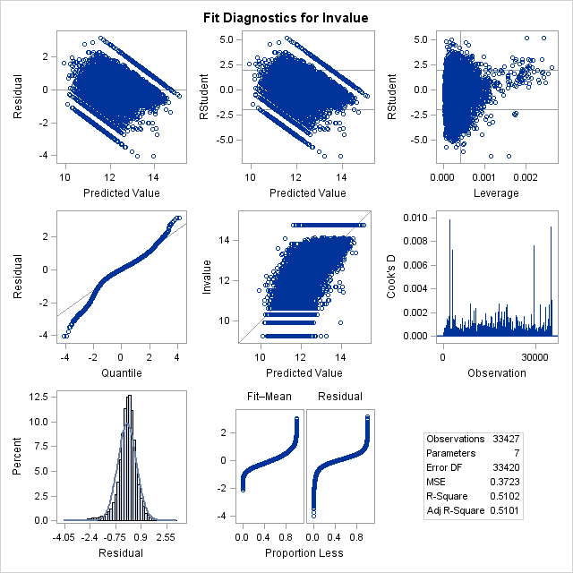
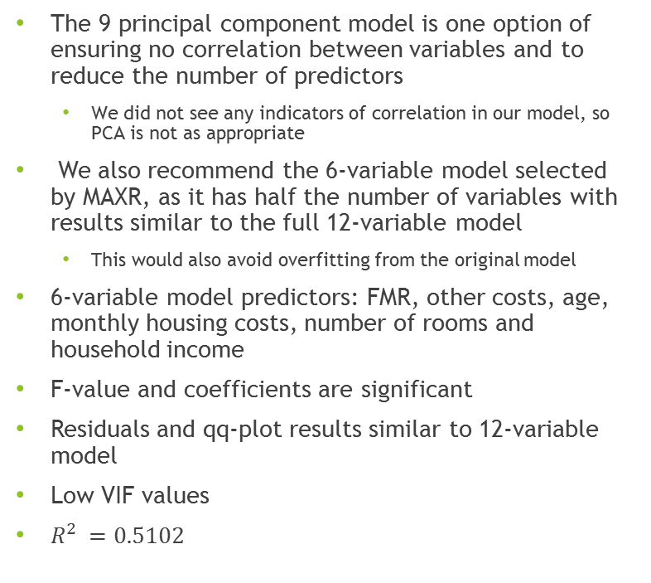
Recommended Model for Market Value
The 9 principal component model is one option of ensuring no correlation between variables and to reduce the number of predictors
We did not see any indicators of correlation in our model, so PCA is not as appropriate
We also recommend the 6-variable model selected by MAXR, as it has half the number of variables with results similar to the full 12-variable model
This would also avoid overfitting from the original model
6-variable model predictors: FMR, other costs, age, monthly housing costs, number of rooms and household income
F-value and coefficients are significant
Residuals and qq-plot results similar to 12-variable model
Low VIF values
$R^{2 }=0.5102$

Slide 21
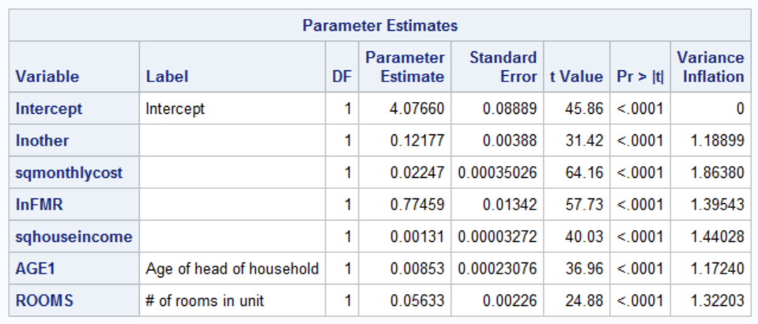
Recommended Model for Market Value
Interesting Points:
FMR (Fair Market Rent) and other household costs are the two most important predictors for current market value in both the 6 and 12 variable models examined
Positive relationships between other costs, fair market rent, household income, number of rooms, age, and monthly costs
Median area income is not significant
Model Equation:
Market Value = 4.077 + 0.122(other costs) + 0.022(monthly housing costs) + 0.775(FMR) + 0.001(household income) + 0.008(age) + 0.056(number of rooms)

Slide 22
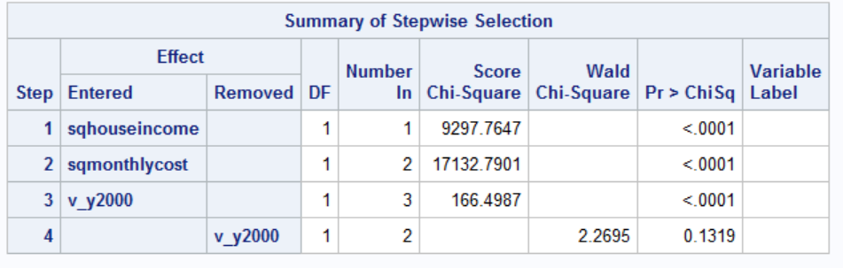
Logistic Regression: Affordability
Logistic regression was performed using the affordable variable (cost burden less than 30% of income)
Goal: Predict whether housing is affordable or not
Input predictors: ROOMS, AGE1, NUNITS, ZINC2, LMED, FMR, ZSMHC, BUILT, REGION, METRO3, OTHERCOST, UTILITY, STATUS, BEDRMS, OWNRENT, PER, STRUCTURETYPE
All categorical predictors were referenced using base class = 0 in logistic regression
Stepwise Selection Results (Significance set to 0.05):
Only household income and monthly cost are significant

Slide 23
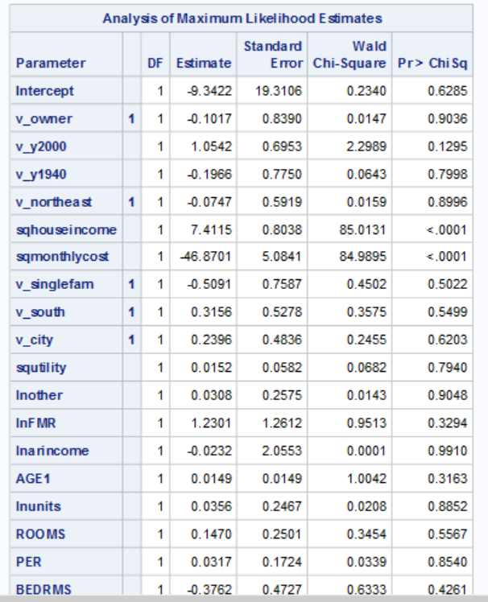
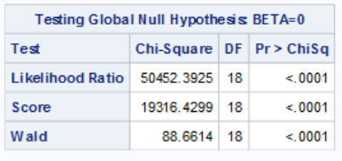
Logistic Regression: Affordability
Interesting Points:
Regression output shows all predictors have insignificant p-values except for household income and monthly costs
These 2 variables are the dominant predictors influencing the probability of housing being affordable

Slide 24
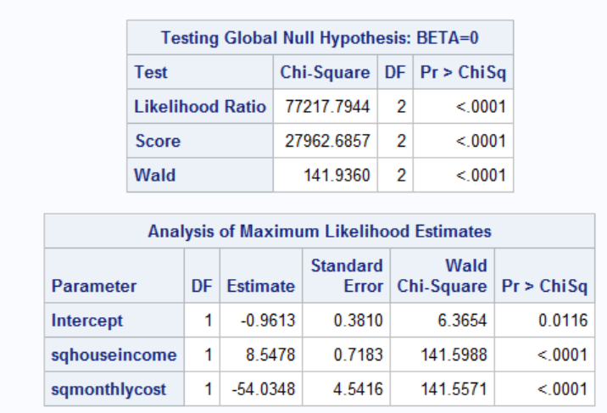
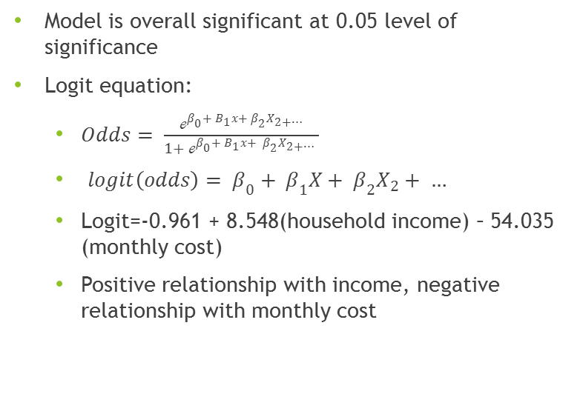
Logistic Regression: Affordability
Model is overall significant at 0.05 level of significance
Logit equation:
$Odds= \frac{ℯ^{β_{0}+ B_{1}x+ β_{2}X_{2+…}}}{1+ ℯ^{β_{0}+ B_{1}x+ β_{2}X_{2+…}} }$
$logit\left(odds\right)= β_{0}+ β_{1}X+ β_{2}X_{2}+ …$
Logit=-0.961 + 8.548(household income) – 54.035 (monthly cost)
Positive relationship with income, negative relationship with monthly cost

Slide 25

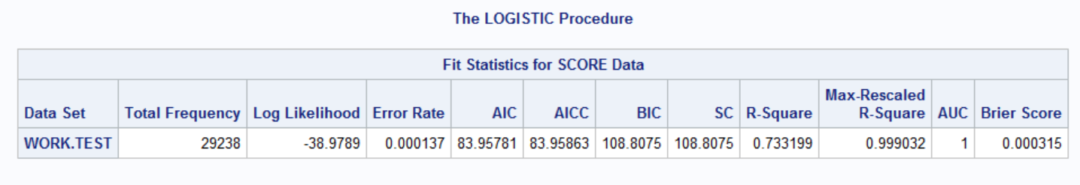
Evaluation of Models
Original dataset split into 2 separate sets: training and test data to evaluate effectiveness of model predictions
The test data set was scored using the training dataset
Results:
Evaluation for market price linear regression result:
Evaluation for affordability logistic regression result:

Slide 26
Conclusions
Summary:
There are many factors that affect the current market value of housing
However, the market value seems to be mostly determined by 6 factors: household income, FMR, monthly cost, other costs, age and number of rooms
Housing affordability is strongly determined by household income and monthly costs
When trying additional models for predicting household income and FMR, we got similar predictors to those seen in the market value and affordability models
It appears many of the variables we examined in our dataset are important/significant for mulitple types of predictions (several different target variables)

Slide 27
Conclusions
Significance:
Allow realtors, home owners & buyers to forecast market value of houses/apartments to ensure fair and reasonable prices/rates
Housing affordability measures allow future buyers/renters to gauge what type of housing and areas they can/can’t afford
Deployment/Future Work:
Deploy models into actual housing service
Employ distributed system technology, such as MapReduce, to speed up the models/process

Slide 28
Thank You!

Slide 29
References
https://www.data.gov/finance/
https://catalog.data.gov/dataset/housing-affordability-data-system-hads
https://portal.hud.gov/hudportal/HUD?src=/program_offices/comm_planning/affordablehousing/
Larose, Daniel T. Data Mining Methods and Models. Wiley, 2006. Print.

